Slide 1
Sprint-3

Slide 2
content
PERSPECTIVE PROJECTION MATRIX
OPERATING SYSTEM

Slide 3
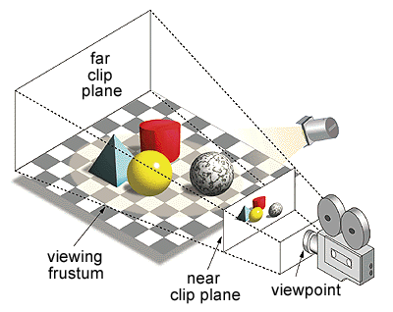
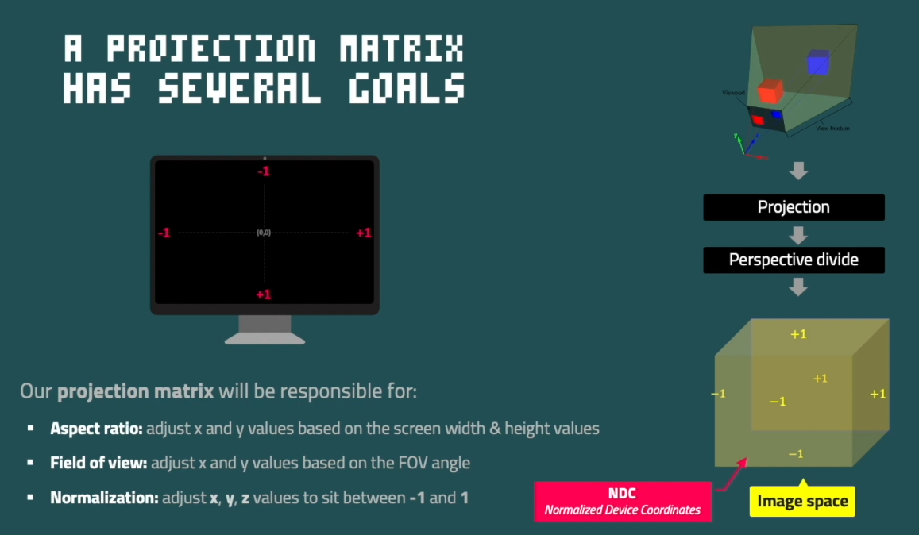
Perspective projection
“Perspective projection or perspective transformation is a projection where three-dimensional objects are projected on a picture plane. This has the effect that distant objects appear smaller than nearer objects.”

Slide 4
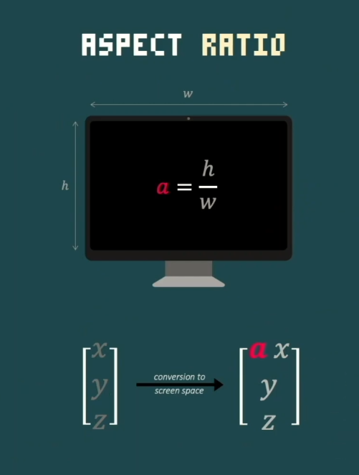

Slide 5
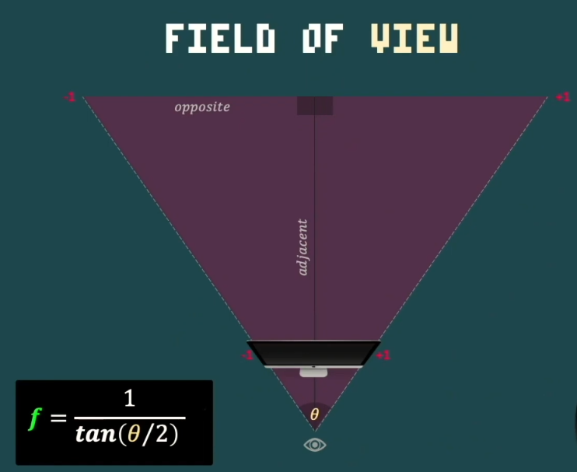

Slide 6
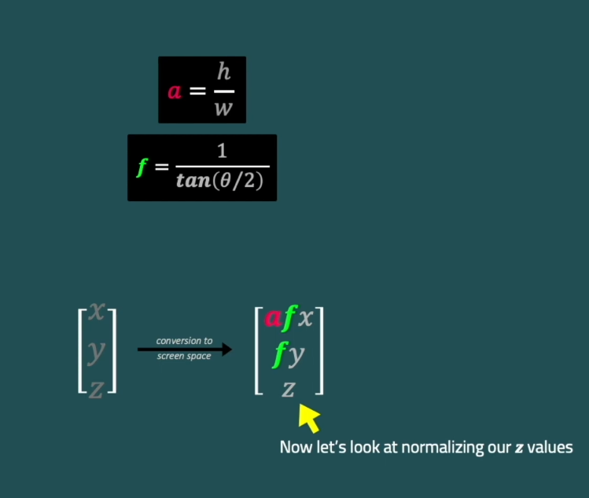

Slide 7
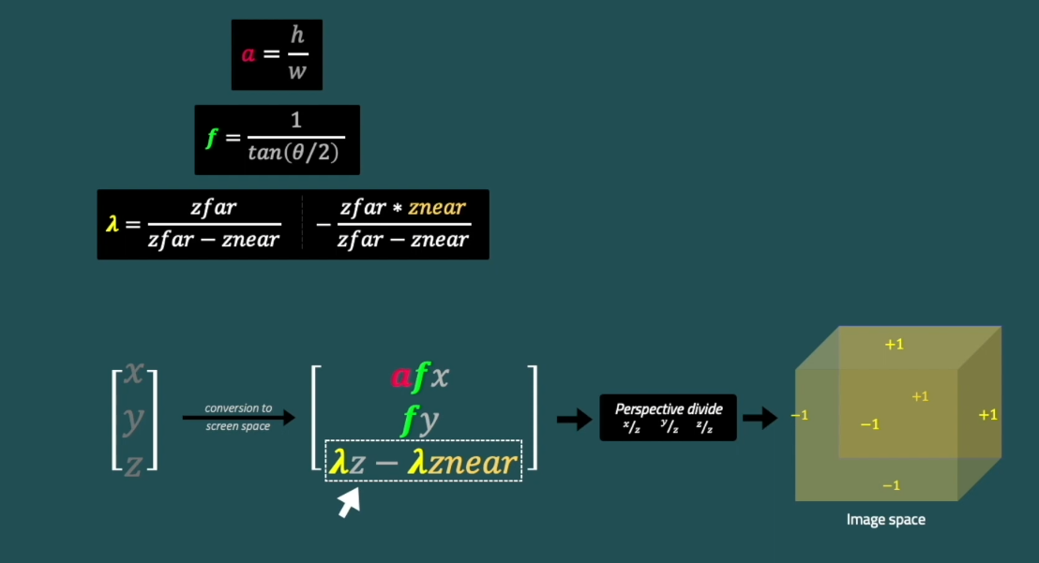

Slide 8
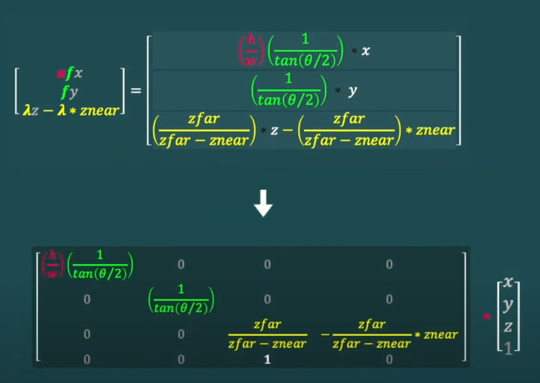

Slide 9
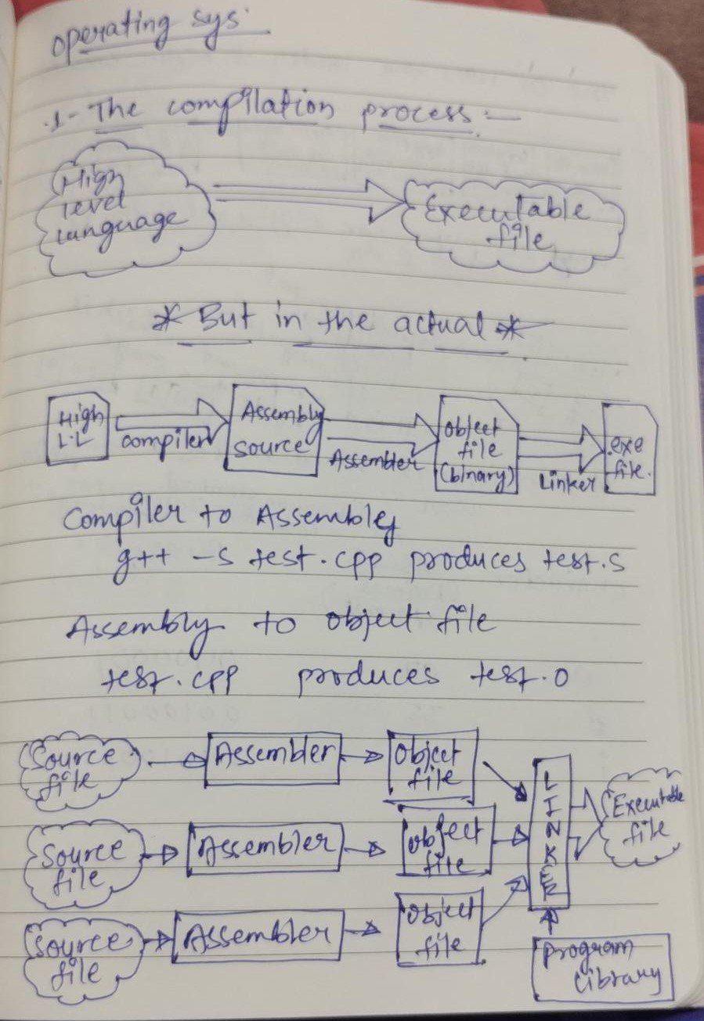

Slide 10
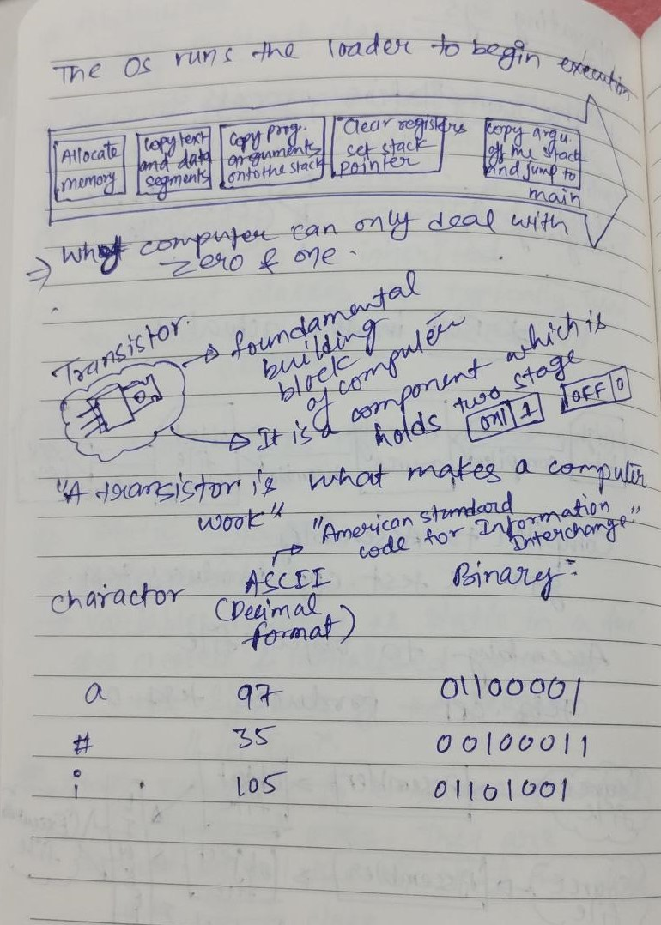

Slide 11
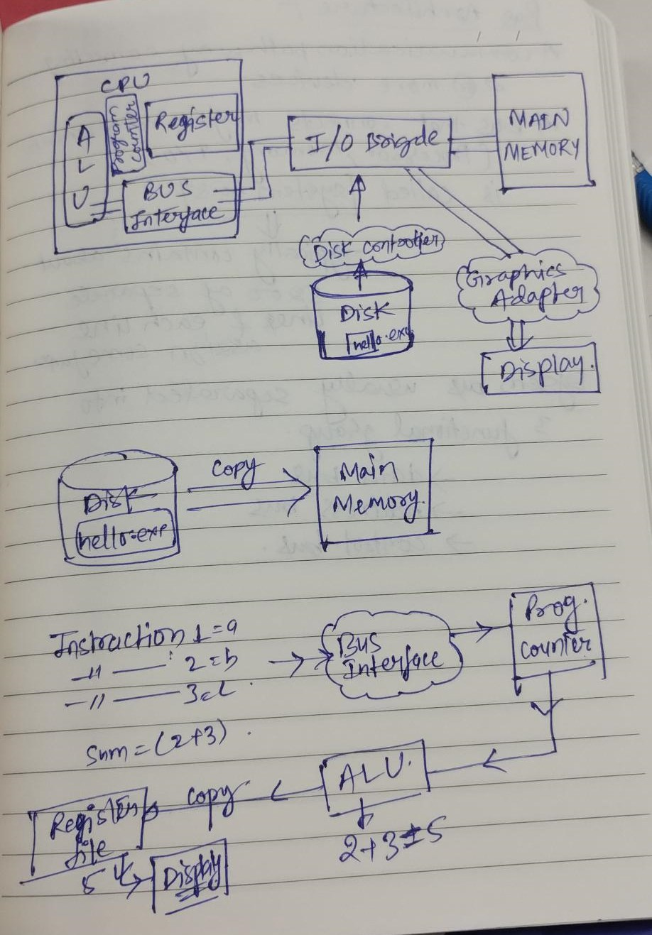

Slide 12
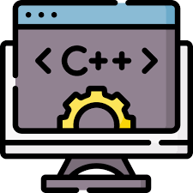
Programming part

Slide 13
Thank you
Shubham Agrahari
Software Engineer Intern
Shubham.agrahari@cyncly.com

